Slide 1
Tog, tog, tog an caisteal (x 3) Aon is dhà is trì
Notes:
Build, build, build the castle (X3) 1, 2, 3

Slide 2
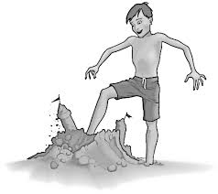
Leag, leag, leag an caisteal (x 3) Aon is dhà is trì
Notes:
Knock down, knock down, knock down the castle (X3) 1, 2, 3

Slide 3
Tog, tog, tog an caisteal (x 3) Aon is dhà is trì
Notes:
Build, build, build the castle (X3) 1, 2, 3

Slide 4
Leag, leag, leag an caisteal (x 3) Aon is dhà is trì
Notes:
Knock down, knock down, knock down the castle (X3) 1, 2, 3

