Slide 1


Seall!
Seo losgann!
Tha e uaine.
Notes:
Look!
Here’s a frog!
It is green.

Slide 2
Seall!
Seo muncaidh!
Tha e donn.
Notes:
Look!
Here’s a monkey!
It is brown.

Slide 3

Seall!
Seo each beag!
Tha e dubh.
Notes:
Look!
Here’s a little horse!
It is black.

Slide 4

Seall!
Seo tunnag!
Tha i buidhe.
Notes:
Look!
Here’s a duck!
It is yellow.

Slide 5
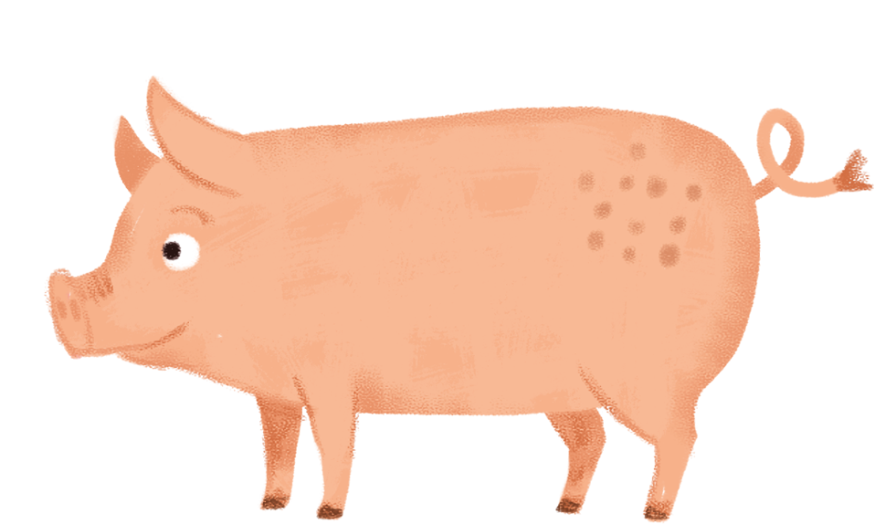
Seall!
Seo muc!
Tha i pinc.
Notes:
Look!
Here’s a pig!
It is pink.

Slide 6
Seall!
Seo iasg!
Tha e orains.
Notes:
Look!
Here’s a fish!
It is orange.

Slide 7
Seall!
Seo ailbhean!
Tha e glas.
Notes:
Look!
Here’s an elephant!
It is grey.

