Slide 1
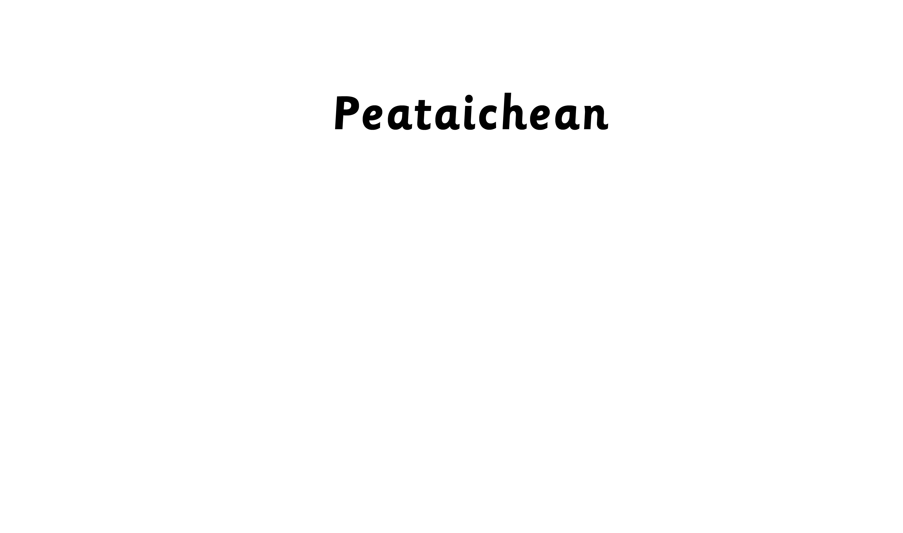

Notes:
Pets

Slide 2
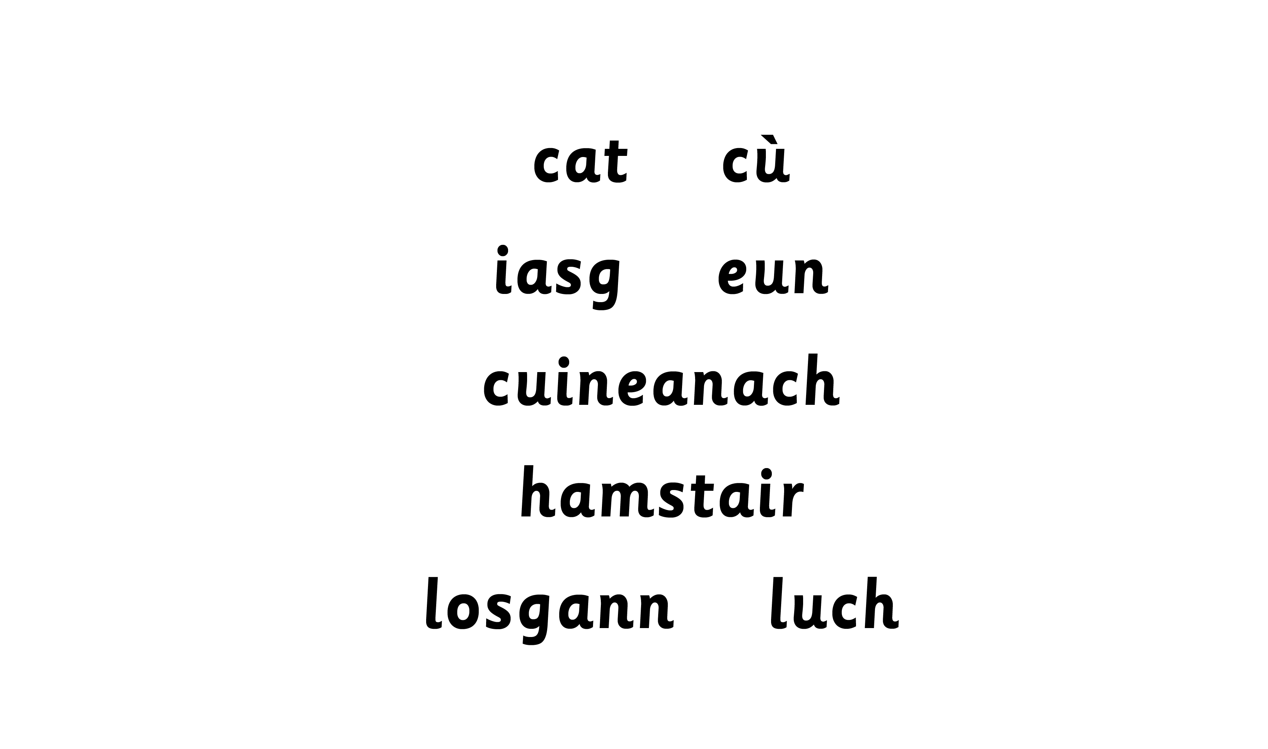
Notes:
dog

Slide 3
Notes:
cat

Slide 4
Notes:
bird

Slide 5
Notes:
fish

Slide 6
Notes:
mouse

Slide 7
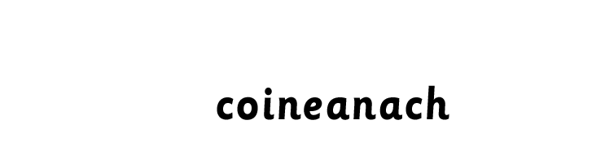
Notes:
rabbit

Slide 8
Notes:
hamster

Slide 9

Dè th’ ann?
’S e … a th’ ann.
Notes:
What is it? It’s a …

