Slide 1
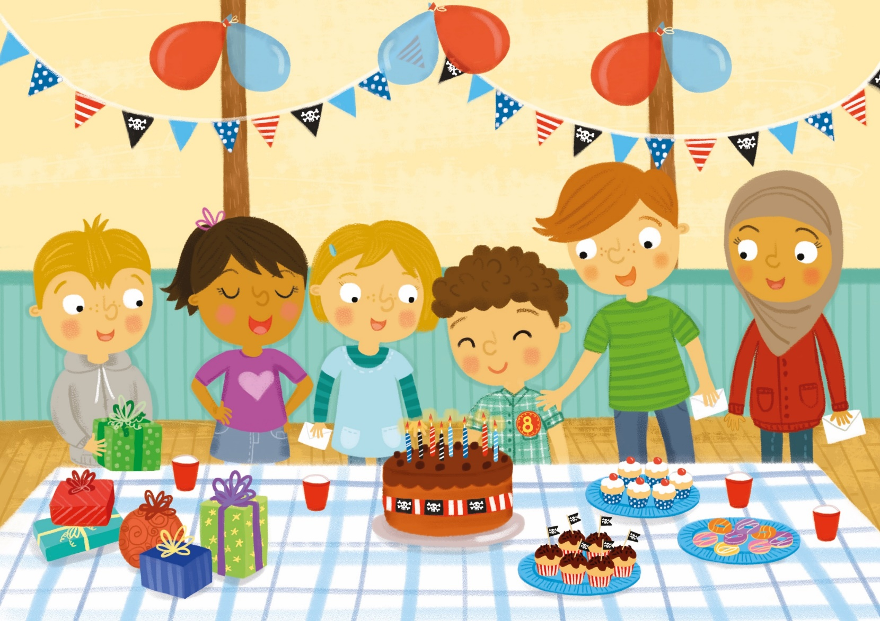
!
Meal do naidheachd!
7
Notes:
Congratulations! (Used for happy birthday too.)

