Slide 1
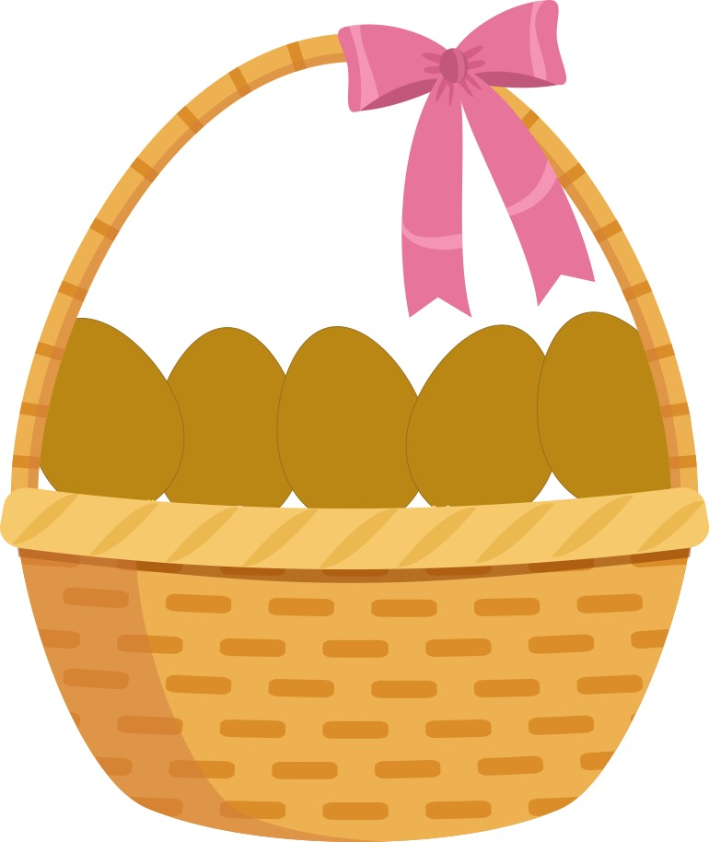
Còig uighean ann am basgaid, uighean donn, uighean donn.
Notes:
Five eggs in a basket, brown eggs, brown eggs.

Slide 2
Thàinig Màiri air a socair;
Agus thug i leatha aon.
Cia mheud ugh a th’ ann a-nis?
Notes:
Mary came quietly
And she took one away with her
How many eggs are there now?

Slide 3
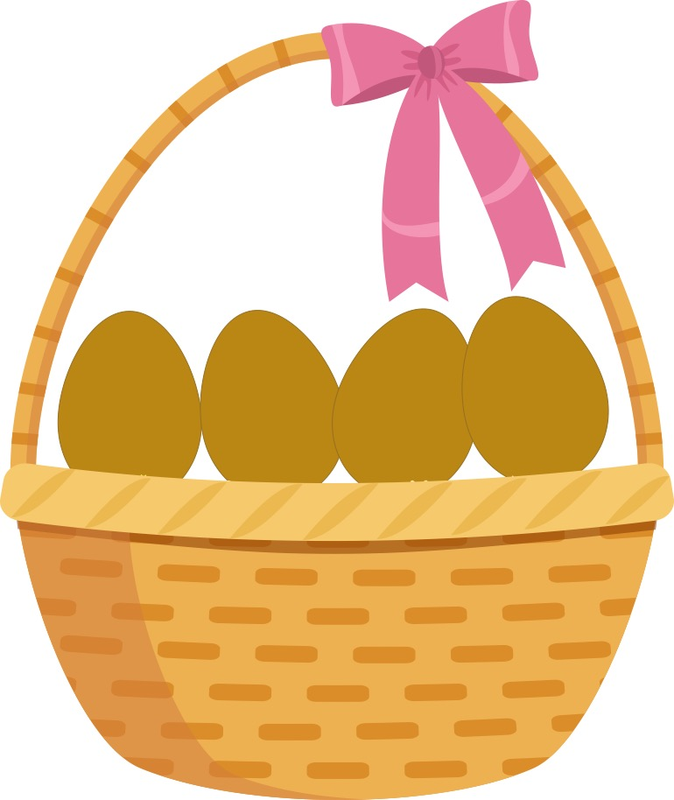
1
2
3
4
A ceithir!
(Aon, dhà, trì, ceithir)
Notes:
4! 1,2,3,4

Slide 4
Ceithir uighean ann am basgaid, uighean donn, uighean donn.
Notes:
Four eggs in a basket, brown eggs, brown eggs.

Slide 5
Thàinig Màiri air a socair;
Agus thug i leatha aon.
Cia mheud ugh a th’ ann a-nis?
Notes:
Mary came quietly
And she took one away with her
How many eggs are there now?

Slide 6
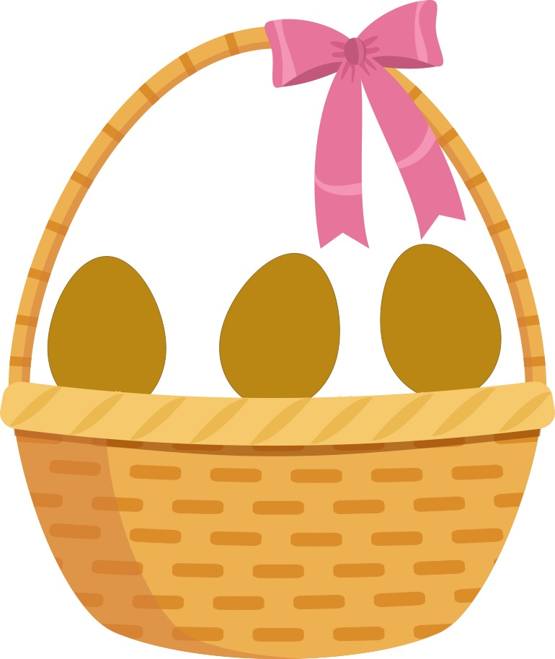
1
2
3
A trì!
(Aon, dhà, trì)
Notes:
3! 1,2,3

Slide 7
Trì uighean ann am basgaid, uighean donn, uighean donn.
Notes:
Three eggs in a basket, brown eggs, brown eggs.

Slide 8
Thàinig Màiri air a socair;
Agus thug i leatha aon.
Cia mheud ugh a th’ ann a-nis?
Notes:
Mary came quietly
And she took one away with her
How many eggs are there now?

Slide 9
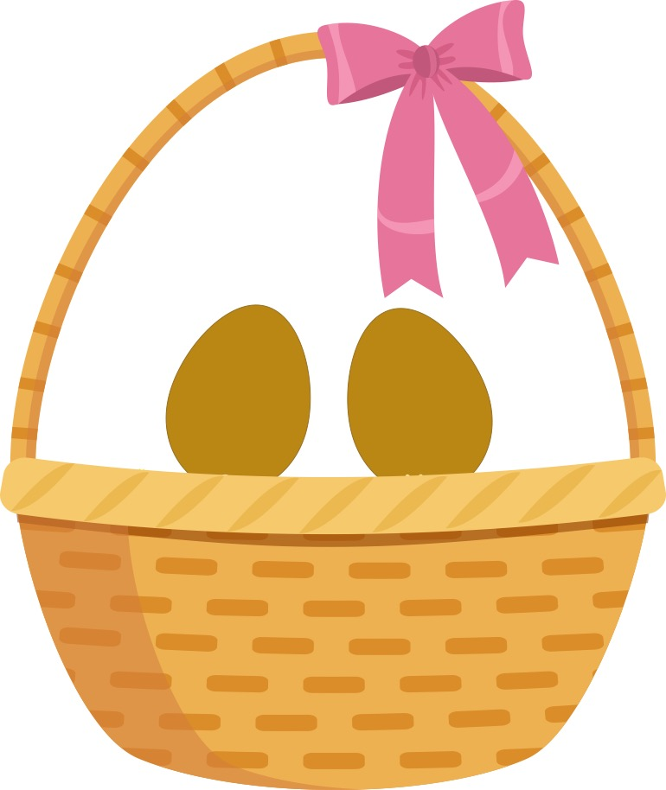
1
2
A dhà!
(Aon, dhà)
Notes:
2! 1,2

Slide 10
Dà ugh ann am basgaid,
uighean donn, uighean donn.
Notes:
Two eggs in a basket, brown eggs, brown eggs.

Slide 11
Thàinig Màiri air a socair;
Agus thug i leatha aon.
Notes:
Mary came quietly
And she took one away with her

