Slide 1
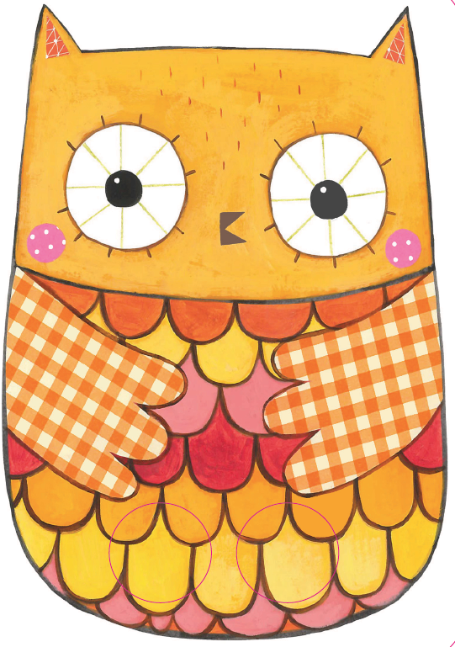
Seo Comhachag.
’S e cailleach-oidhche a th’ innte.
Notes:
Here’s Comhachag.
It’s an owl.

Slide 2
Bidh i ag ràdh, ‘Tu-uit tu-ù.’
Notes:
It makes (the sound) ‘Toowit toowoo.’

Slide 3
Bidh i a’ dol suas agus sìos .
Notes:
It goes up and down.

Slide 4
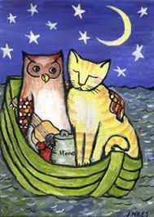
Seall!
Notes:
Look!

Slide 5
Chaidh a’ chailleach-oidhche ’s a’ phiseag gu muir
Ann am bàta beag uaine grinn
Thug iad leotha pàipear còig not
Le mil agus airgead na bhroinn
Notes:
The owl and the pussy cat went to sea
In a pretty, little green boat
They took some honey and plenty of money
‘Wrapped up’ in a £5 note

