Slide 1
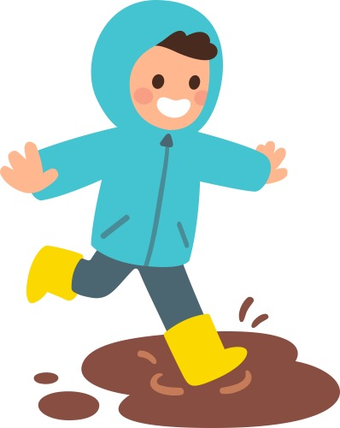
Tha sinn a’ splaiseadh anns na lòintean
Tha sinn a’ splaiseadh anns na lòintean
Tha sinn a’ splaiseadh anns na lòintean
Fad an latha, gach latha
Notes:
We are splashing in the puddles X3
All day, everyday

Slide 2
Splisidh, splaisidh anns na lòintean
Splisidh, splaisidh anns na lòintean
Splisidh, splaisidh anns na lòintean
Fad an latha, gach latha
Notes:
Splishy, splashy in the puddles X3
All day, everyday

Slide 3
Tha spòrs againn anns na lòintean
Tha spòrs againn anns na lòintean
Tha spòrs againn anns na lòintean
Fad an latha, gach latha
Notes:
We are having fun in the puddles X3
All day, everyday

Slide 4
Splisidh, splaisidh anns na lòintean
Splisidh, splaisidh anns na lòintean
Splisidh, splaisidh anns na lòintean
Fad an latha, gach latha
Notes:
Splishy, splashy in the puddles X3
All day, everyday

