Slide 1


feur
Notes:
grass

Slide 2
craobh
Notes:
tree

Slide 3
craobhan
Notes:
trees

Slide 4

flùr
Notes:
flower

Slide 5

flùraichean
Notes:
flowers

Slide 6
abhainn
Notes:
river

Slide 7
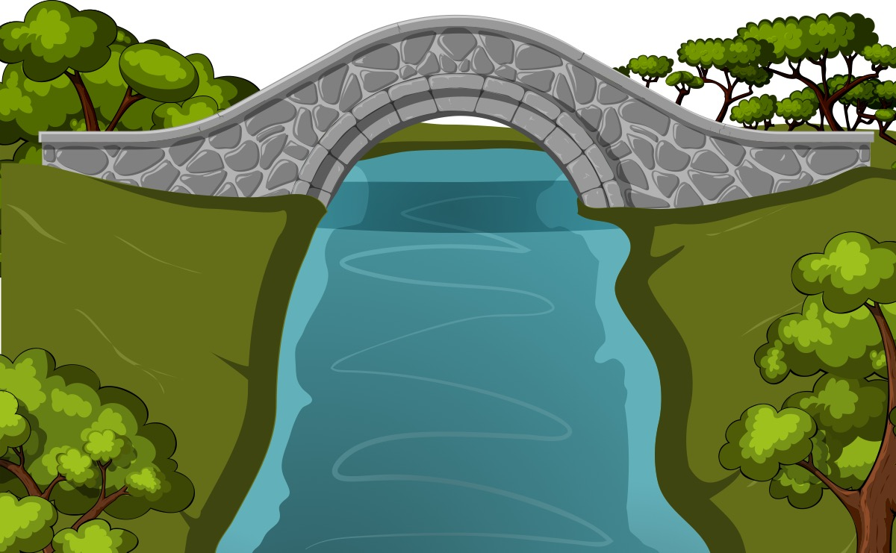
drochaid
Notes:
bridge

Slide 8

lòn
Notes:
puddle

Slide 9
lòintean
Notes:
puddles

Slide 10

poll
Notes:
mud

