Slide 1
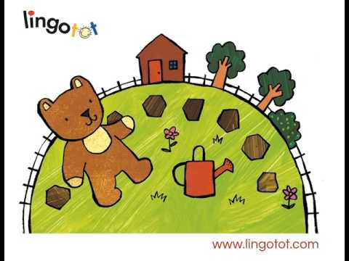
Timcheall a’ gharraidh, chaidh am mathan mòr
Aon cheum, dà cheum, diogladh gu leòr.
Notes:
Round the garden
Went the big bear
One step, two steps
Lots of tickling

