Slide 1
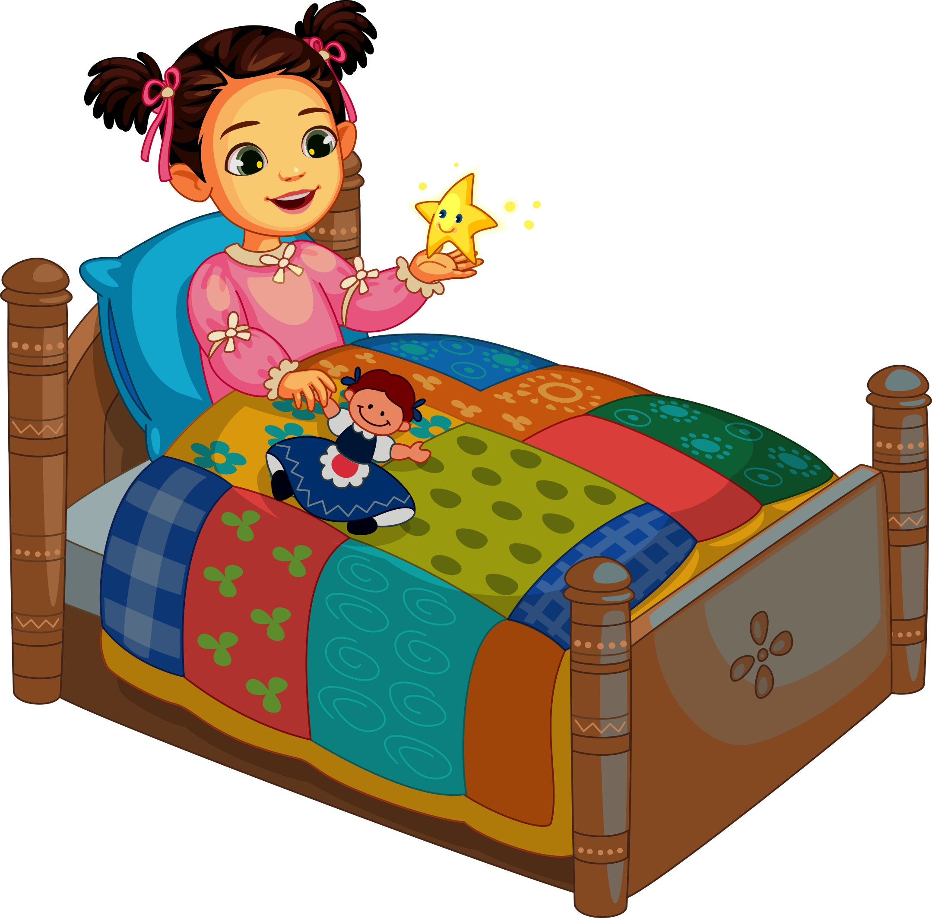
Priob-priob priob-priob, rionnag bheag
Saoil a-nis cò thu no dè?
Notes:
Twinkle, twinkle little star
I wonder who or what you are.

Slide 2
Àrd os cionn an t-saoghail gu lèir
’s tu mar ghrìogag anns an speur
Notes:
High above the whole world
Like a jewel in the sky/heaven(s)

Slide 3
Priob-priob priob-priob, rionnag bheag
Saoil a-nis cò thu no dè?
Notes:
Twinkle, twinkle little star
I wonder who or what you are.

Slide 4
Priob-priob priob-priob, rionnag bheag
Saoil a-nis cò thu no dè?
Notes:
Twinkle, twinkle little star
I wonder who or what you are.

Slide 5
Àrd os cionn an t-saoghail gu lèir
’s tu mar ghrìogag anns an speur
Notes:
High above the whole world
Like a jewel in the sky/heaven(s)

Slide 6
Priob-priob priob-priob, rionnag bheag
Saoil a-nis cò thu no dè?
Notes:
Twinkle, twinkle little star
I wonder who or what you are.

