Slide 1

Mòr!
Notes:
Big!

Slide 2
Tha cluasan mòra air ailbhean.
Notes:
An elephant has big ears.

Slide 3
Tha ceann mòr air each.
Notes:
A horse has a big head.

Slide 4
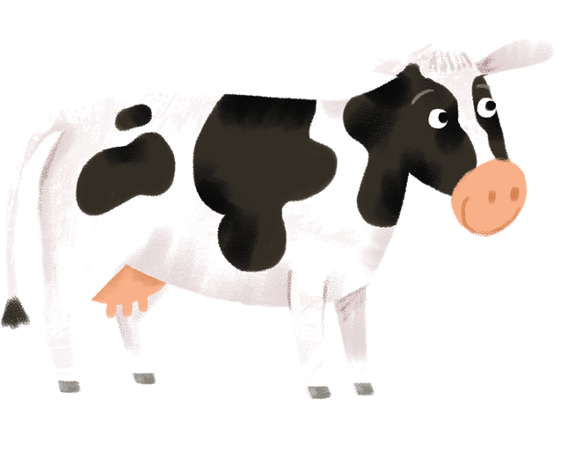
Tha sròn mhòr air bò.
Notes:
A cow has a big nose.

Slide 5
Tha beul mòr air crogall.
Notes:
A crocodile has a big mouth.

Slide 6
Tha sùilean mòra air cailleach oidhche.
Notes:
An owl has big eyes.

