Slide 1
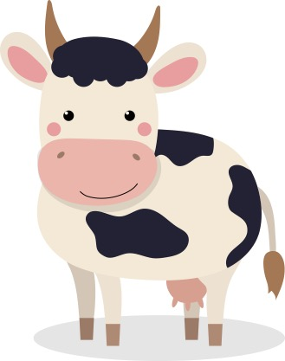
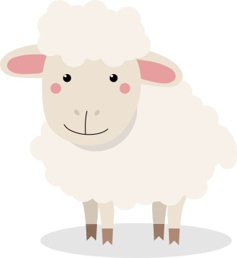
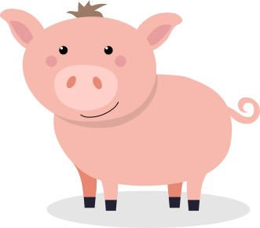
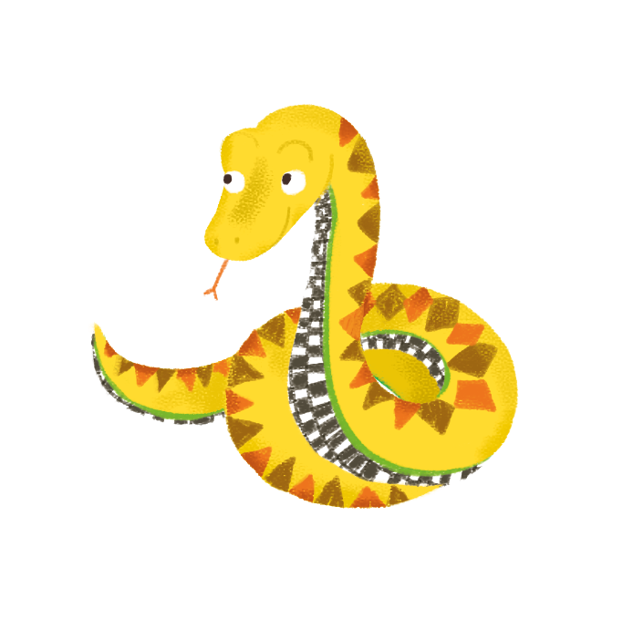
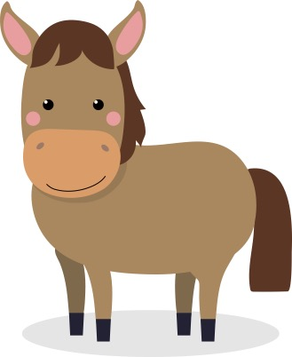
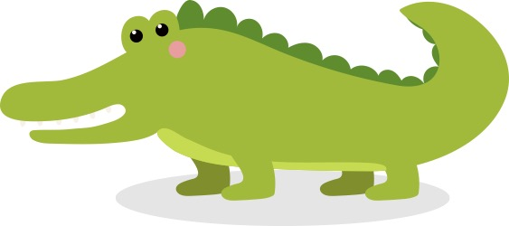
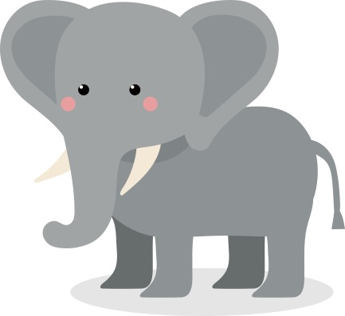
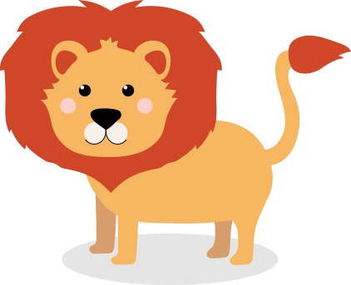
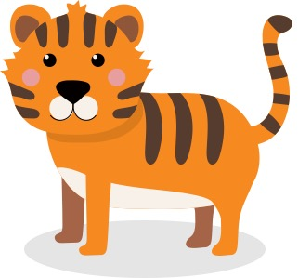
Guthan nam beathaichean
Notes:
Animals’ ‘Voices’

Slide 2
Dè tha seo?
Seo bò.
Notes:
What is this? This is a cow.

Slide 3
Dè bhios bò ag ràdh?
Notes:
What does a cow say?

Slide 4
Bidh bò ag ràdh, ‘Mù, mù, mù!’
Notes:
A cow says, ‘Moo, moo, moo!’

Slide 5
Dè tha seo?
Seo caora.
Notes:
What is this? This is a sheep.

Slide 6
Dè bhios caora ag ràdh?
Notes:
What does a sheep say?

Slide 7
Bidh caora ag ràdh, ‘Mè, mè, mè!’
Notes:
A sheep says, ‘Meh, meh, meh!’

Slide 8
Dè tha seo?
Seo muc.
Notes:
What is this? This is a pig.

Slide 9
Dè bhios muc ag ràdh?
Notes:
What does a pig say?

Slide 10
Bidh muc ag ràdh, ‘Oinc, oinc, oinc!’
Notes:
A pig says, ‘Oink, oink, oink!’

Slide 11
Dè tha seo?
Seo each.
Notes:
What is this? This is a horse.

Slide 12
Dè bhios each ag ràdh?
Notes:
What does a horse say?

Slide 13
Bidh each ag ràdh, ‘Nè, nè, nè!’
Notes:
A horse says, ‘Neigh, neigh, neigh!’

Slide 14
Dè tha seo?
Seo crogall.
Notes:
What is this? This is a crocodile.

Slide 15
Dè bhios crogall ag ràdh?
Notes:
What does a crocodile say?

Slide 16
Bidh crogall ag ràdh,
‘Cnac, cnac, cnac!’
Notes:
A crocodile says, Snap, snap, snap!’

Slide 17
Dè tha seo?
Seo nathair.
Notes:
What is this? This is a snake.

Slide 18
Dè bhios nathair ag ràdh?
Notes:
What does a snake say?

Slide 19
Bidh nathair ag ràdh, ‘Sss, sss, sss!’
Notes:
A snake says, ‘Sss, sss, sss!’

Slide 20
Dè tha seo?
Seo ailbhean.
Notes:
What is this? This is an elephant.

Slide 21
Dè bhios ailbhean ag ràdh?
Notes:
What does an elephant say?

Slide 22
Bidh ailbhean ag ràdh, ‘Uàrr,uàrr,uàrr!’
Notes:
An elephant says, ‘Uarr, uarr, uarr!’

Slide 23
Dè tha seo?
Seo leòmhann.
Notes:
What is this? This is a lion.

Slide 24
Dè bhios leòmhann ag ràdh?
Notes:
What does a lion say?

Slide 25
Bidh leòmhann ag ràdh, ‘Ràrr, ràrr, ràrr!’
Notes:
A lion says, ‘Roar, roar, roar!’

Slide 26
Dè tha seo?
Seo tìgear.
Notes:
What is this? This is a tiger.

Slide 27
Dè bhios tìgear ag ràdh?
Notes:
What does a tiger say?

Slide 28
Bidh tìgear ag ràdh, ‘Ràrr, ràrr, ràrr!’
Notes:
A tiger says, ‘Roar, roar, roar!’

