Slide 1


Dathan
Notes:
Colours

Slide 2
dearg
Notes:
red

Slide 3

gorm
Notes:
blue

Slide 4
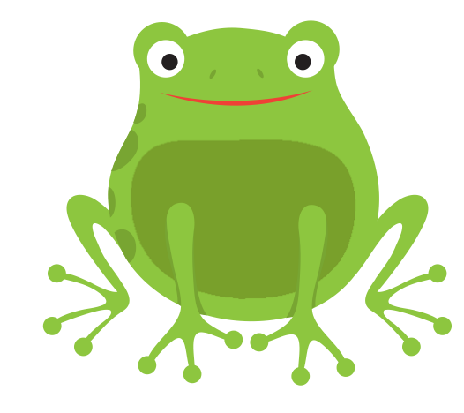
uaine
Notes:
green

Slide 5
buidhe
Notes:
yellow

Slide 6
dubh
Notes:
black

Slide 7

geal
Notes:
white

Slide 8

orains
Notes:
orange

Slide 9
purpaidh
Notes:
purple

Slide 10

donn
Notes:
brown

Slide 11
glas
Notes:
grey

