Slide 1
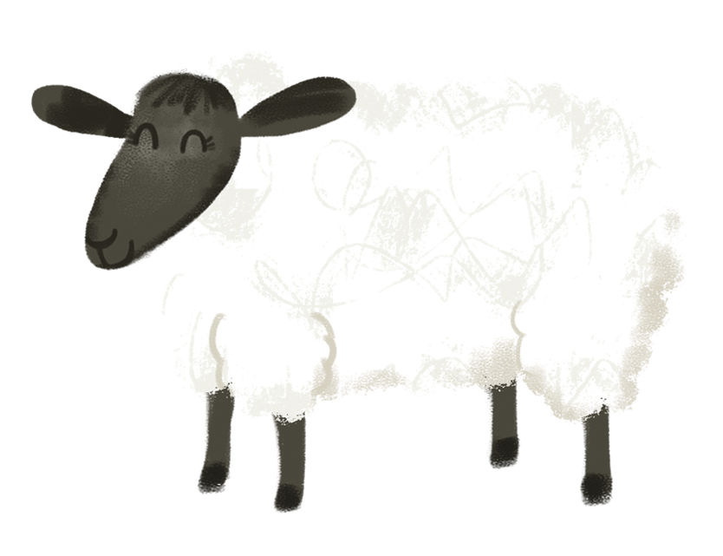
Aon chaora gheal
Notes:
One white sheep

Slide 2
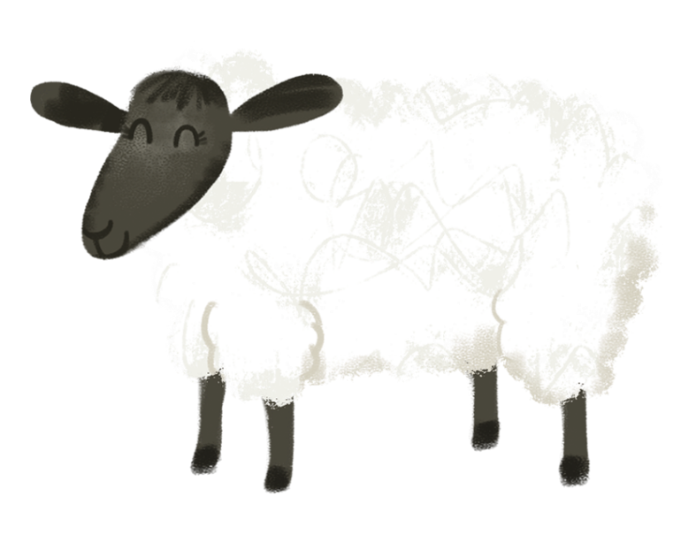
Aon chaora gheal ag ithe feur.
Thàinig caora eile ag ràdh,
‘Tha an t-acras ormsa cuideachd.’
Notes:
One white sheep eating grass. Along came another sheep saying, ‘I’m hungry too.’

Slide 3
Dà chaora gheal ag ithe feur.
Thàinig caora eile ag ràdh,
‘Tha an t-acras ormsa cuideachd.’
Notes:
Two white sheep eating grass. Along came another sheep saying, ‘I’m hungry too.’

Slide 4
Trì caoraich gheala ag ithe feur. Thàinig caora eile ag ràdh, ‘Tha an t-acras ormsa cuideachd.’
Notes:
Three white sheep eating grass. Along came another sheep saying, ‘I’m hungry too.’

Slide 5
Ceithir caoraich gheala ag ithe feur. Thàinig caora eile ag ràdh, ‘Tha an t-acras ormsa cuideachd.’
Notes:
Four white sheep eating grass. Along came another sheep saying, ‘I’m hungry too.’

Slide 6
Còig caoraich gheala ag ithe feur. Cha tàinig caora eile ’s dh’ith iad feur gu leòr.
Notes:
Five white sheep eating grass. No other sheep came and they ate grass a plenty.

