Slide 1
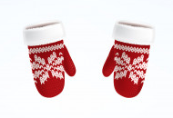
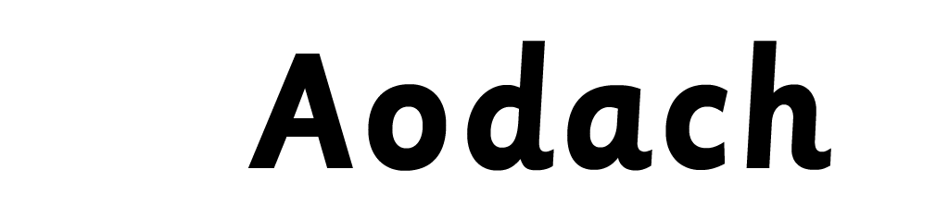


Notes:
Clothes

Slide 2
brògan
Notes:
shoes

Slide 3
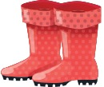

bòtannan
Notes:
boots

Slide 4
bonaid
Notes:
hat

Slide 5
miotagan
Notes:
Gloves/mittens

Slide 6
còta
Notes:
coat

Slide 7
seacaid
Notes:
jacket

Slide 8
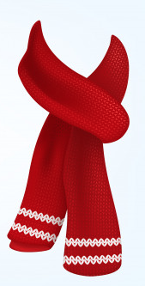
sgarfa
Notes:
scarf

Slide 9
stocainnean
Notes:
socks

Slide 10
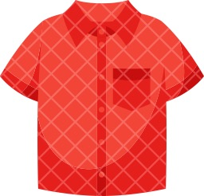
lèine
Notes:
shirt

Slide 11
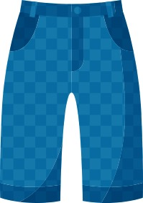
briogais
Notes:
trousers

Slide 12
sgiort
Notes:
skirt

Slide 13

dreasa
Notes:
dress

Slide 14
briogais ghoirid
Notes:
shorts

Slide 15
lèine-t
Notes:
T shirt

Slide 16
geansaidh
Notes:
jumper

Slide 17
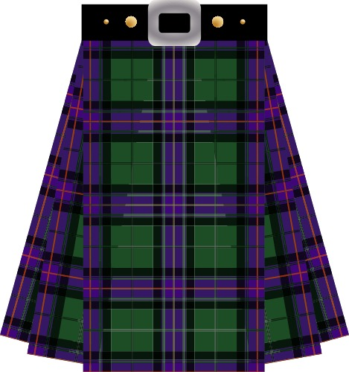
fèileadh
Notes:
kilt

