Slide 1
Notes:
The weather

Slide 2
Notes:
How is the weather?

Slide 3
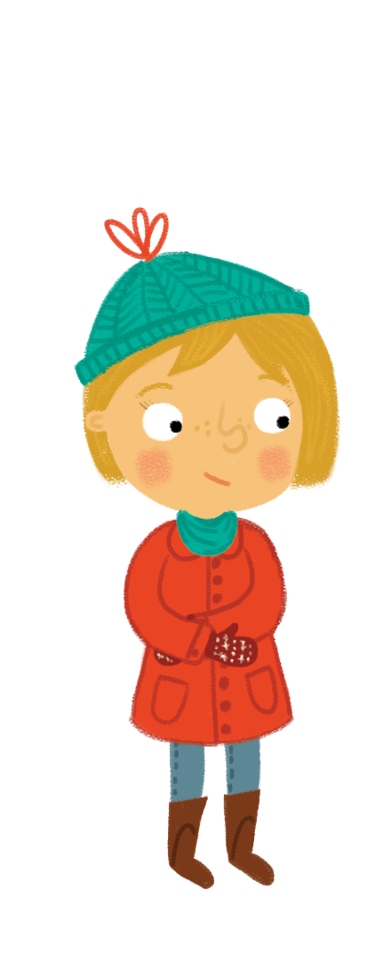
Notes:
It is cold.

Slide 4
Notes:
How is the weather?

Slide 5
Notes:
It is cloudy.

Slide 6
Notes:
How is the weather?

Slide 7
Notes:
It is wild/windy.

Slide 8
Notes:
How is the weather?

Slide 9
Notes:
It is wet.

Slide 10
Notes:
How is the weather?

Slide 11
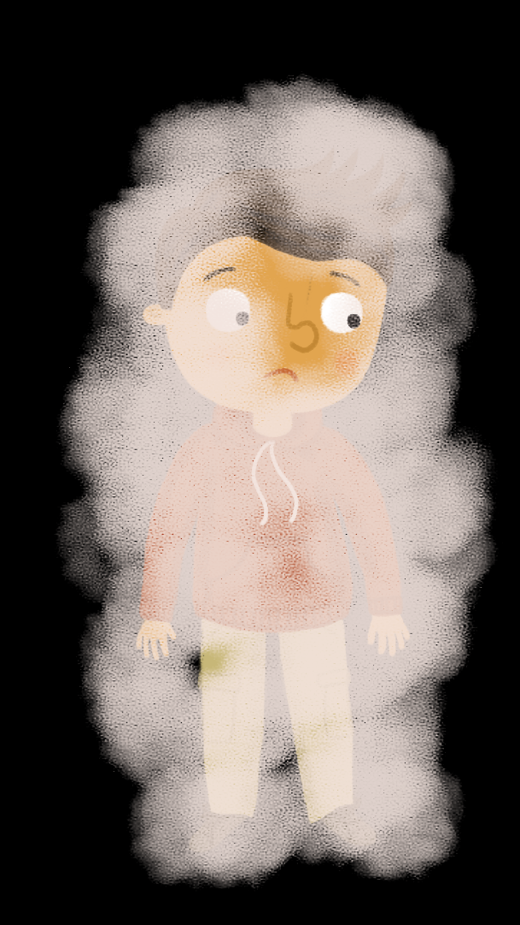
Notes:
It is foggy.

Slide 12
Notes:
How is the weather?

Slide 13
Notes:
It is sunny.

Slide 14
Notes:
How is the weather?

Slide 15
Notes:
It is lovely.

Slide 16
Notes:
How is the weather?

Slide 17
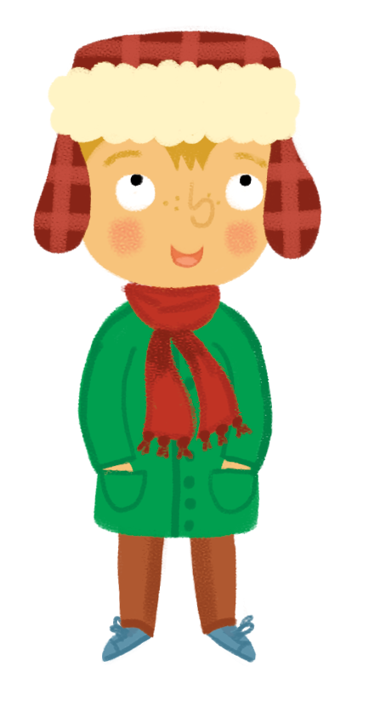
Notes:
It is snowing.

