Slide 1
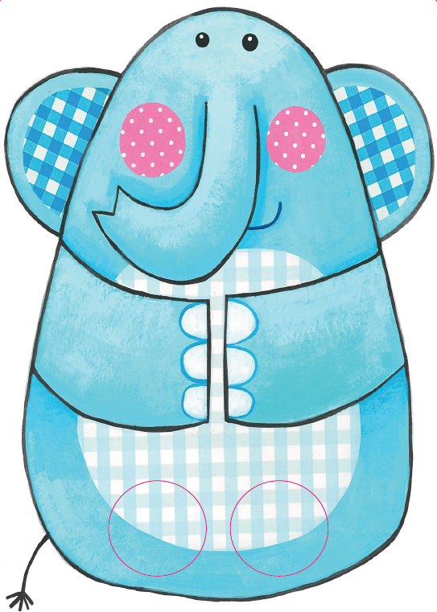
Seo Dùdan.
’S e ailbhean a th’ ann.
Notes:
Here’s Dùdan. He’s/It’s an elephant.

Slide 2
Bidh a shròn a’ seinn.
Notes:
Its/His trunk (nose) sings.

Slide 3
Tha e mòr, làidir.
Notes:
It/He is big and strong.

Slide 4
Bidh ailbhean a’ coiseachd le casan mòra trom
Tha e uabhasach àrd
Agus uabhasach cruinn
Bidh ailbhean a’ coiseachd le casan mòra trom
Ag ithe nan geugan ’s
A’ sèideadh ’s a’ seinn.
Notes:
An elephant walks with big heavy legs.
It is very tall and very round.
An elephant walks with big heavy legs.
Eating tree branches and blowing and singing.

