Slide 1
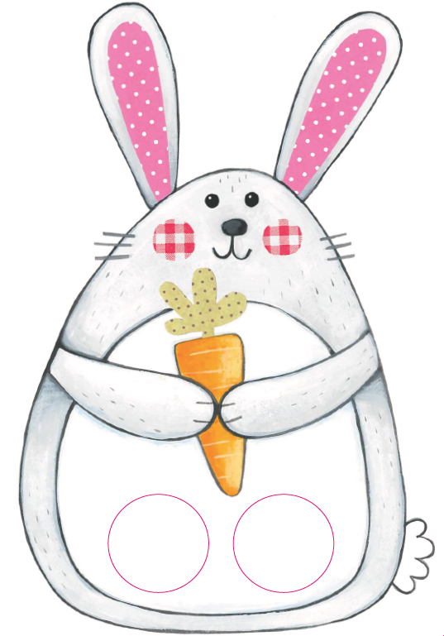
Seo Calum.
’S e coineanach a th’ ann.
Notes:
Here’s Calum. He’s/It’s a rabbit.

Slide 2
Tha e glas.
Notes:
He/it is grey.

Slide 3
Is toigh leis curran.
Notes:
He/it likes a carrot/carrots.

Slide 4
Bidh e a’ ruith ’s a’ leum anns a’ phàirc.
Notes:
He runs and jumps in the park.

Slide 5
Seall Calum Coineanach is cuileag air a cheann
Seall Calum Coineanach is cuileag air a cheann
Seall Calum Coineanach
is cuileag air a cheann
Rinn e suis is rinn e suais ’s cha robh e idir ann.
Notes:
Look at Calum rabbit and a fly on his head X3
He did swish and swash and it wasn’t there at all.

Slide 6
Seall Calum Coineanach is cuileag air a shròin
Seall Calum Coineanach is cuileag air a shròin
Seall Calum Coineanach is cuileag air a shròin
Rinn e suis is rinn e suais is leag e i le spòig
Notes:
Look at Calum rabbit and a fly on his nose. X3
He did swish and swash and knocked it away with his paws.

