Slide 1
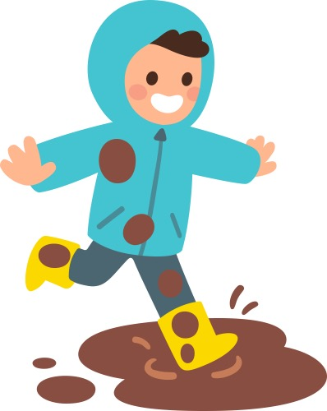
Poll bog air mo mhiotagan,
Poll bog air mo chòta,
Poll bog air mo stocainnean,
Poll bog air mo bhrògan.
Notes:
Wet mud on my gloves
Wet mud on my coat
Wet mud on my socks
Wet mud on my shoes

Slide 2
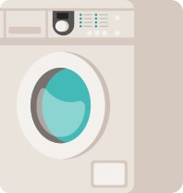
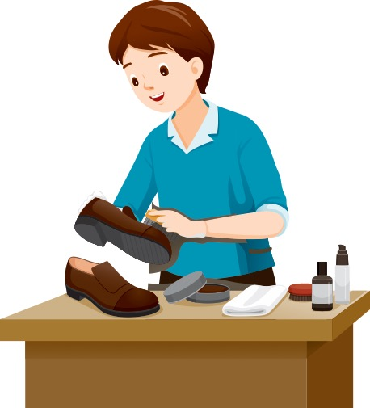
Nighidh mi mo mhiotagan;
Nighidh mi mo chòta;
Nighidh mi mo stocainnean
Is glanaidh mi mo bhrògan.
Notes:
I will wash my gloves
I will wash my coat
I will wash my socks
I will clean my shoes

