Slide 1
Tha e fliuch a-muigh an-diugh,
Tha e fliuch a-muigh an-diugh,
Tha e fliuch a-muigh an-diugh,
A’ splaiseadh anns na lòintean.
Notes:
It is wet outside today
It is wet outside today
It is wet outside today
Splashing in the puddles

Slide 2
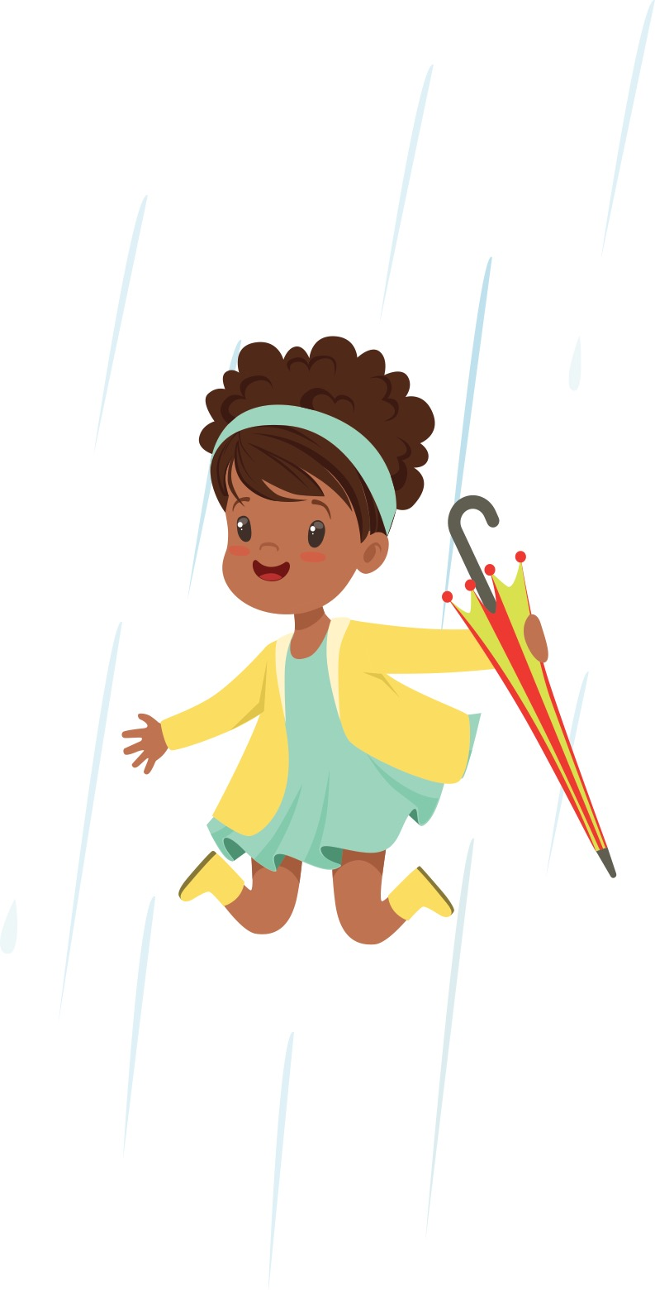
Tha mo chòta fliuch a-nis
Tha mo chòta fliuch a-nis
Tha mo chòta fliuch a-nis
Thig a-steach ’s thoir dhìot e.
Notes:
My coat is wet now
My coat is wet now
My coat is wet now
Come inside and take it off

Slide 3
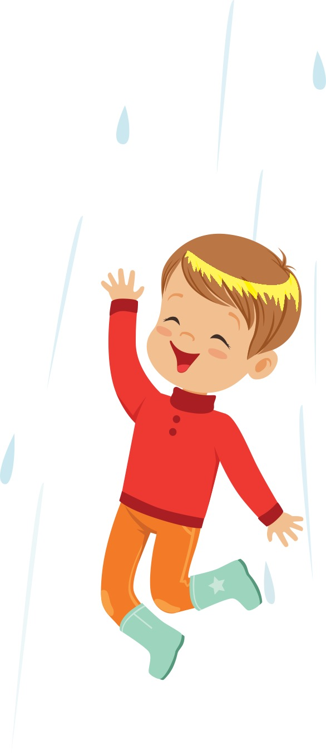
Tha mo bhrògan fliuch a-nis,
Tha mo bhrògan fliuch a-nis,
Tha mo bhrògan fliuch a-nis,
Thig a-steach ’s thoir dhìot iad.
Notes:
My shoes are wet now
My shoes are wet now
My shoes are wet now
Come inside and take them off

Slide 4
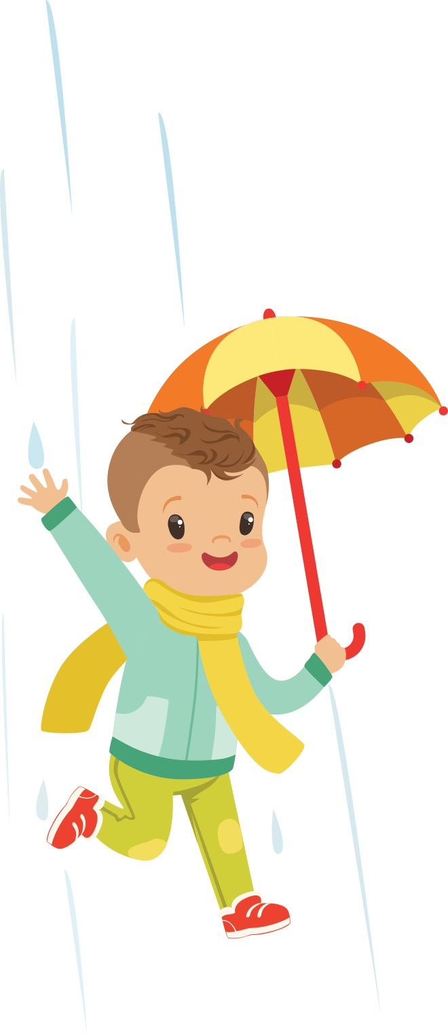
Tha mo stocainnean fliuch a-nis,
Tha mo stocainnean fliuch a-nis,
Tha mo stocainnean fliuch a-nis,
Thig a-steach ’s thoir dhìot iad.
Notes:
My socks are wet now
My socks are wet now
My socks are wet now
Come inside and take them off

